Slide 1
Uas Delivery vERification System
By: Group 24
Senior Design II
Presentation Date: April 20th 2017

Slide 2
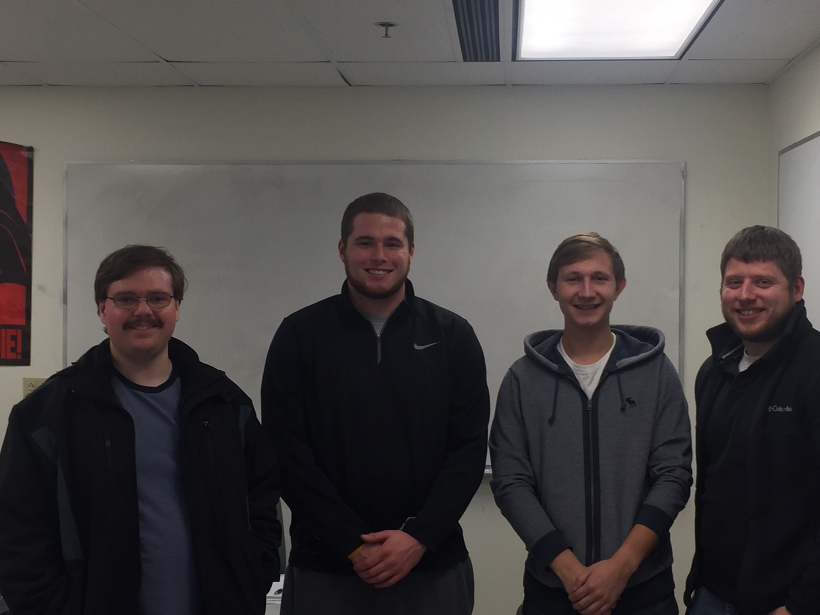
Our Team
Justin Rutschilling – Electrical Engineering
Carl Schmidt – Electrical Engineering
Kirill Kultinov – Computer Science
Nathan Nichols – Electrical Engineering

Slide 3
Overview
Project Goals/ Dependencies
Approach to Design
Approach to Testing
Summary of Results
Video Demonstration
Conclusions

Slide 4
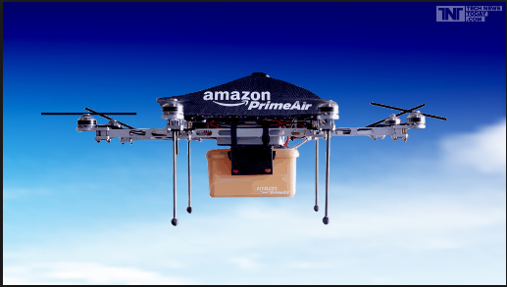
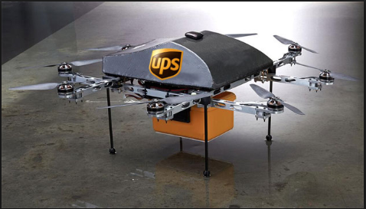
Initial Project Goals/Dependencies
Ensure safe and proper delivery of packages via UAS
Provide a service to companies such as Amazon and UPS
Provide a mobile application to work in conjunction with hardware on UAS for Android and iOS devices.
Dependent on companies to allow us access to implement our system onto their UASs.
Dependent on users to be prepared to receive package
Figure 1
Source: [1]
Figure 2
Source: [2]

Slide 5
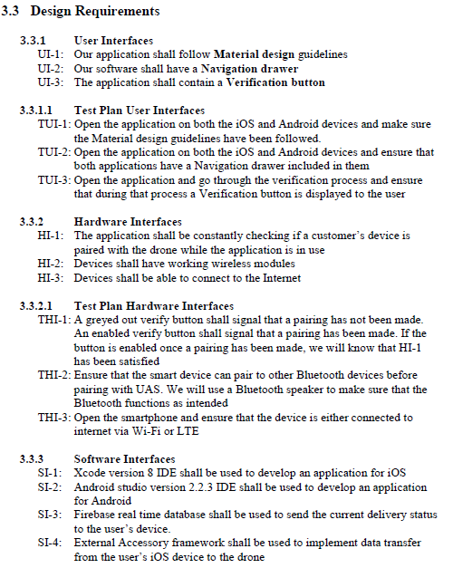
Initial Project Goals/Dependencies
To have a working prototype prepared in time to demonstrate by the end of the semester
To adhere to all of the requirements laid out in Design Specification Document
Figure 3: A few of our Requirements
Source: [Justin Rutschilling]

Slide 6
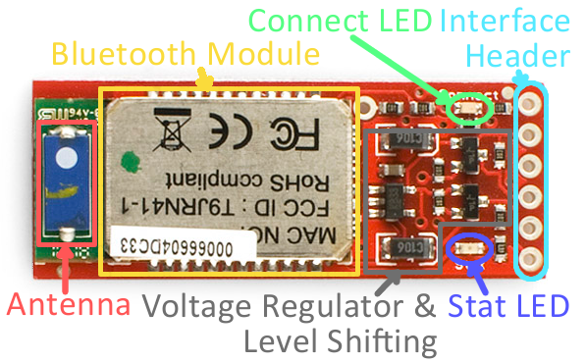
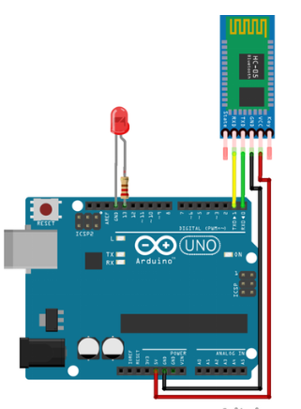
Design Approach Hardware
Verified parts we wanted to order in fact would work
Ordered hardware components
Initial hardware testing
Figure 4
Source: [9]
Figure 5
Source: [10]

Slide 7
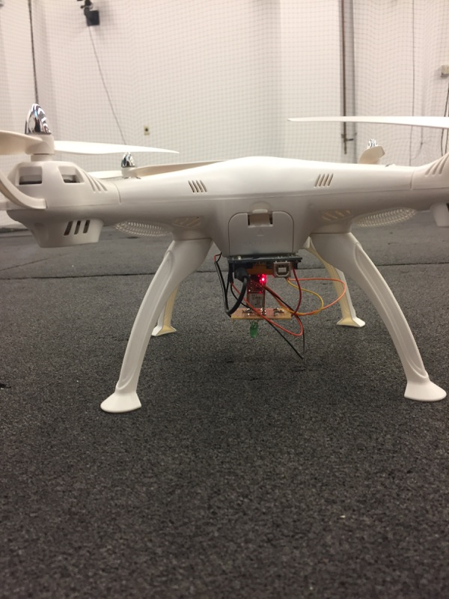
Design Approach Hardware
Hardware assembly
Programming the hardware components to send and receive data
Integration onto UAS
Enable hardware components to work in accordance with our application
Figure 6
Source: [Justin Rutschilling]

Slide 8
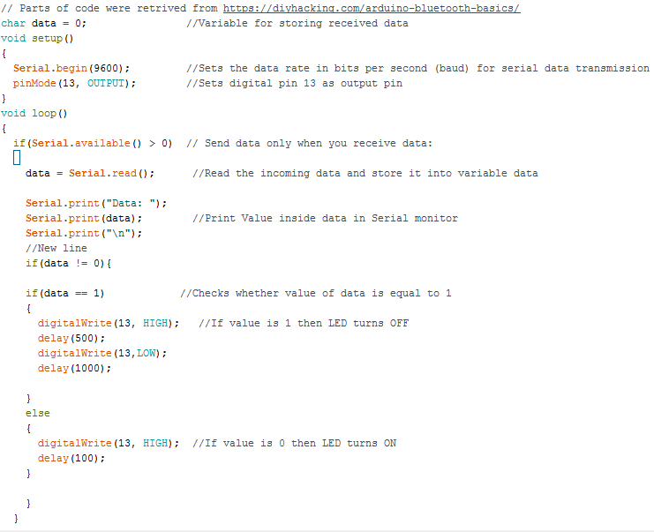
Design Approach Hardware
The Arduino was programmed using the code in the figure to the right
This code was used to control the Hardware on the UAS to indicate successful delivery
Figure 7
Source: [Justin Rutschilling]

Slide 9
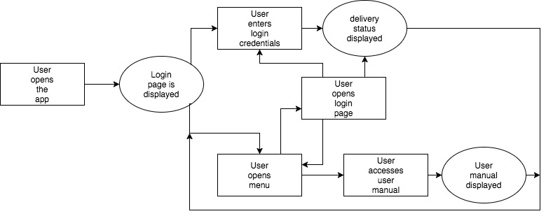
Design Approach Software
How user interacts with the software
Figure 8
Source: [Kirill Kultinov]

Slide 10
Design Approach Software
Create robust application
Implement Material Design with navigation drawer (SWRevealViewController library for iOS)
Save status of view controllers (iOS Coredata, fragments for Android)
Efficiently use memory
Reduce amount of data exchange using Internet connection

Slide 11
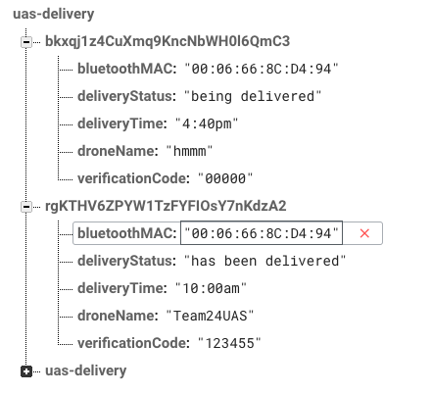
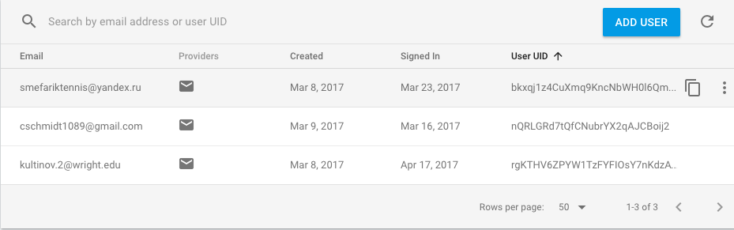
Design Approach Software
What information is needed
Delivery status, MAC address of BlueSmirf, Drone’s name, and verification code for pairing via Bluetooth
Integration with Firebase
Figure 9
Source: [Kirill Kultinov]
Figure 10
Source: [Kirill Kultinov]

Slide 12
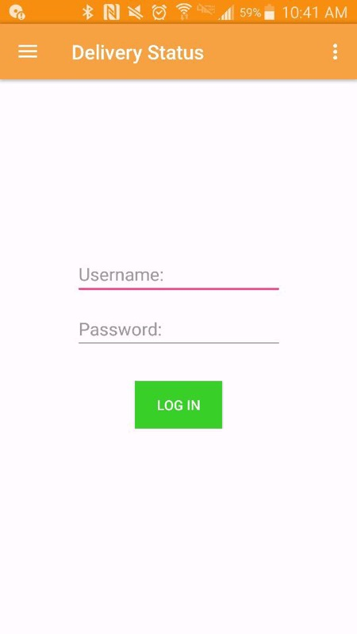
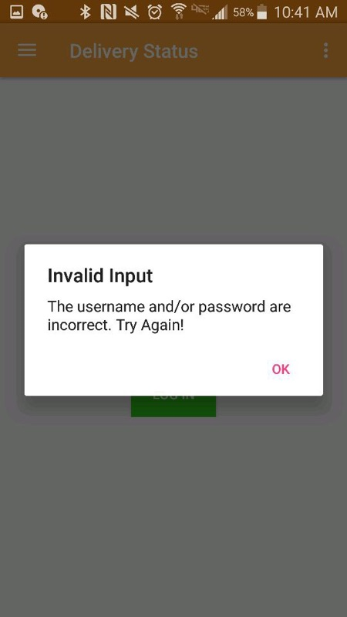
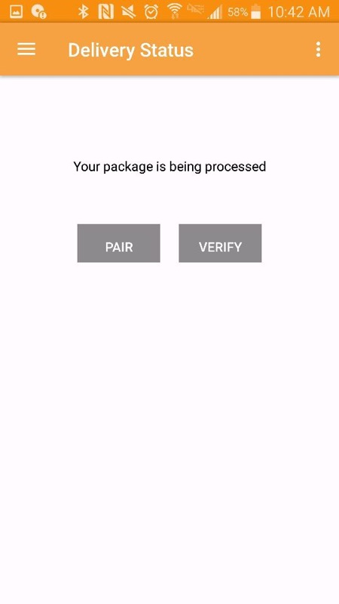
Design Approach Software – Android Application Screenshots
Figure 1 shows the sign in page in the application. Figure 2 shows what is displayed if the wrong login information is used. Figure 3 shows the screen that is displayed after successful login.
Figure 11
Source: [Kirill Kultinov]
Figure 12
Source: [Kirill Kultinov]
Figure 13
Source: [Kirill Kultinov]

Slide 13
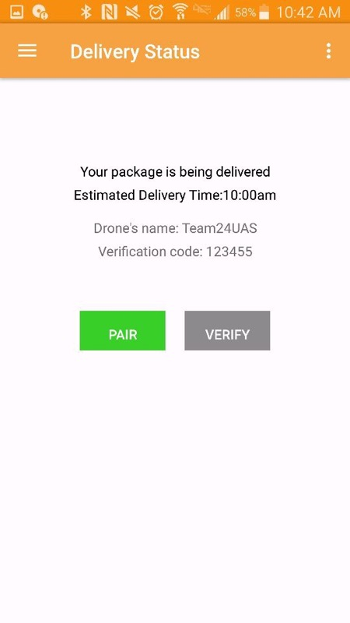
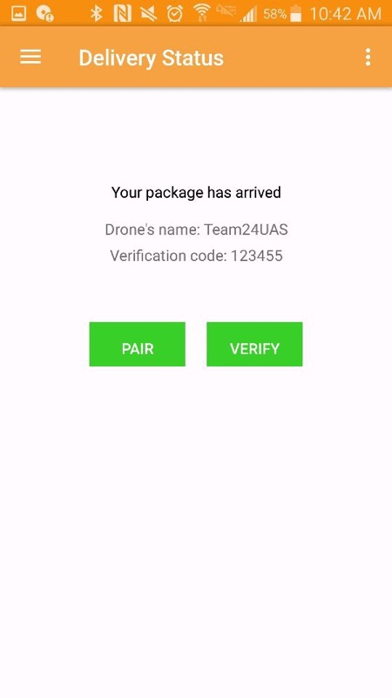
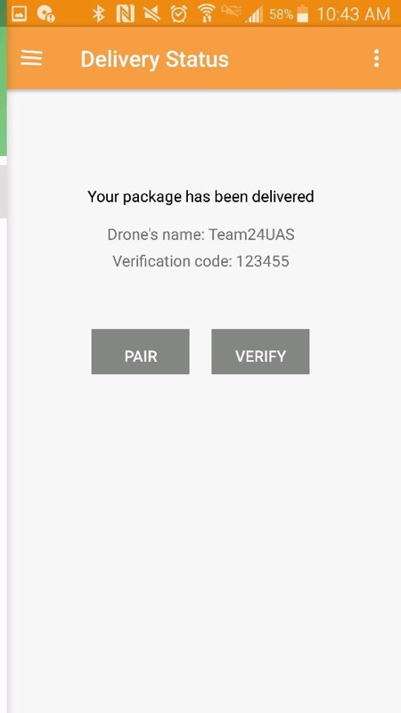
Design Approach Software – Android Application Screenshots
Figure 1 shows that the package is on its way and provides the UAS name, verification code, and estimated delivery time. Figure 2 is the screen for when the UAS arrives. Figure 3 is the screen for when the package has been delivered.
Figure 14
Source: [Kirill Kultinov]
Figure 15
Source: [Kirill Kultinov]
Figure 16
Source: [Kirill Kultinov]

Slide 14
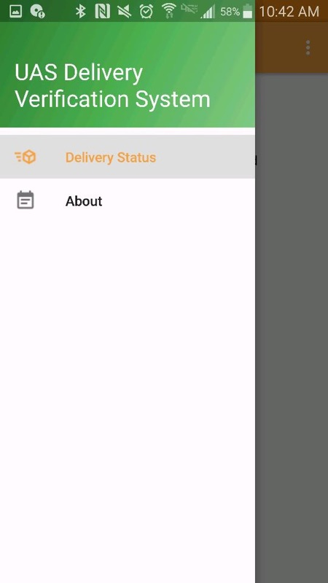
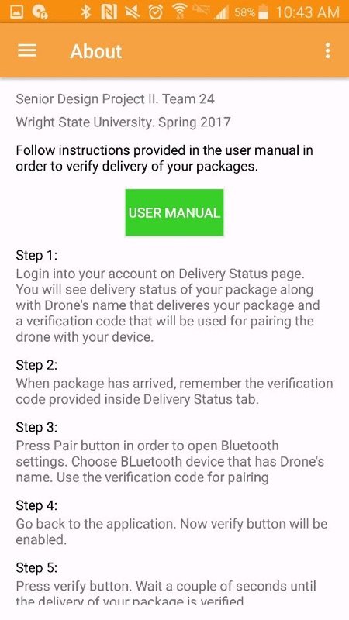
Design Approach Software – Android Application Screenshots
Figure 4 shows a screenshot of the dropdown menu for choosing between the delivery status or choosing the About section of the application. Figure 5 shows the About section and the User Manual for our application.
Figure 17
Source: [Kirill Kultinov]
Figure 18
Source: [Kirill Kultinov]

Slide 15
Approach to Test Requirements
The design was said to meet the requirements if through our testing the threshold was met
The majority of our requirements involved the application we were making
Most of the testing for these requirements were direct observation because of this
Whole system requirements were tested multiple times and deemed passable if they worked a certain number of times
The threshold and objective for our test plan were vastly similar as much of our requirements were software based.
When they differed it was mainly for our hardware requirements

Slide 16
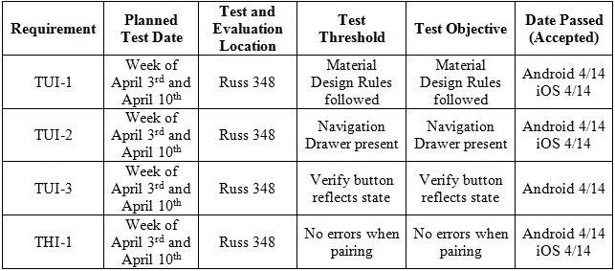
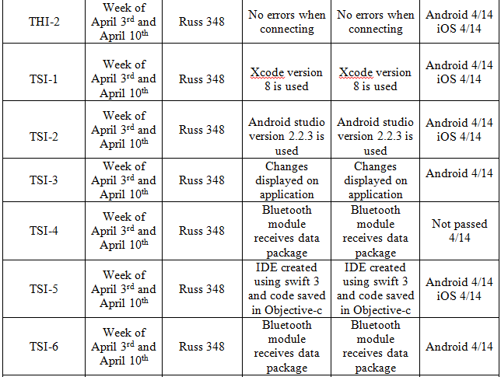
Test Plan/Test Results
Figure 19
Source: [Justin Rutschilling]

Slide 17
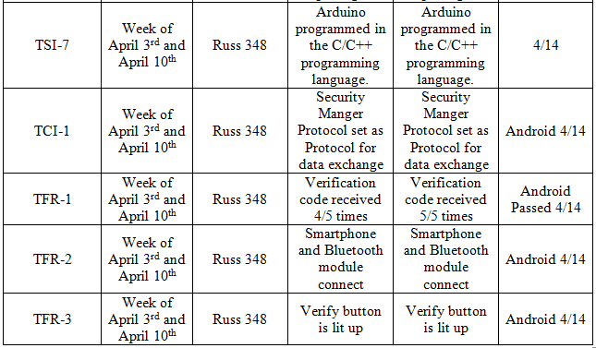
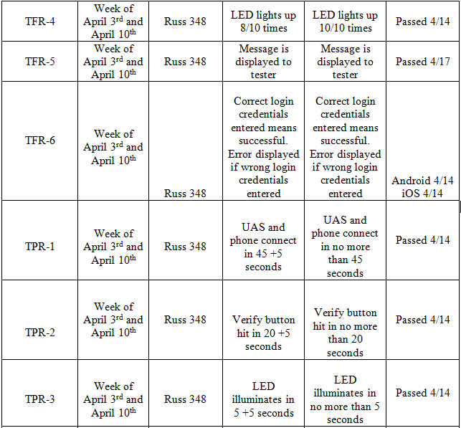
Test Plan/Test Results
Figure 20
Source: [Justin Rutschilling]

Slide 18
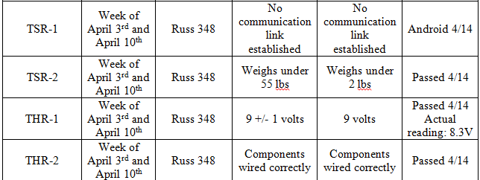
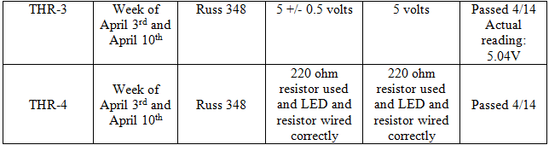
Test Plan/Test Results
Figure 21
Source: [Justin Rutschilling]

Slide 19
Summary of Results
Overall the design meets the requirements, one requirement did not pass because we were unable to successfully send and receive data from our iOS application
Percent of tests actually ran: 96%
The one test we could not test was a test for our iOS application and checking to see if we could send data via Bluetooth
Hardware Requirements passing percentage: 100%
Software Requirements passing percentage: 95%

Slide 20
Summary of Results
Whole system passing percentage: 96%
For most of our test requirements the threshold and objective were the same. This is because the majority of our requirements revolved around our application and in that case it either worked or it didn’t.
For ones that had a different threshold and objective all testing passed both, in a few instances we came close to just passing the threshold though
Whole system failing percentage: 4%
One of failures was around data transfer through Bluetooth for our iOS application

Slide 21
Demo of UAS Delivery Verification System
Demonstration Video

Slide 22
Conclusions
Overall our finished product met most of the goals we laid our for ourselves
Given an additional couple weeks we believe that we could have finished our iOS application.
Looking back could had developed the hardware side of our project more
Could have developed more sensors to give better indication of proper delivery
Could have built our own UAS instead of ordering one

Slide 23
References
[1] S. Brady, “Brand News: Amazon and 7-Eleven Drones, ABInBev Brexit Pinch and More,” brandchannel: 2016. [Online]. Available: http://brandchannel.com/2016/07/26/brand-news-072616/. [Accessed: 21-Nov-2016].
[2] T. O'Brien, “UPS experimenting with delivery drones, set to challenge Amazon's Prime Air,” Engadget, 03-Dec-2013. [Online]. Available: https://www.engadget.com/2013/12/03/ups-experimenting-with-delivery-drones/. [Accessed: 21-Nov-2016].
[3] “Using Swift with Cocoa and Objective-C (Swift 3.0.1): Swift and Objective-C in the Same Project,” Using Swift with Cocoa and Objective-C (Swift 3.0.1): Swift and Objective-C in the Same Project. [Online]. Available: https://developer.apple.com/library/content/documentation/Swift/Conceptual/BuildingCocoaApps/MixandMatch.html. [Accessed: 27-Nov-2016].
[4] "Elevation and shadows - material design - material design guidelines," in Elevation and shadows - Material design, Material design guidelines. [Online]. Available: https://material.google.com/material-design/elevation-shadows.html#elevation-shadows-shadows. Accessed: Nov. 27, 2016.
[5] M. Jenkins, “Arduino Pinout Diagrams,” marcusjenkins.com, 13-Jun-2014. [Online]. Available: http://marcusjenkins.com/arduino-pinout-diagrams/. [Accessed: 23-Jan-2017].
[6] Arduino.cc. [Online]. Available: https://www.arduino.cc/en/Main/ArduinoBoardUno. Accessed: Nov. 22, 2016.
[7] "Installing the Arduino* IDE,". [Online]. Available: https://software.intel.com/en-us/get-started-arduino-install. Accessed: Nov. 21, 2016
[8] “SparkFun Bluetooth Modem - BlueSMiRF Silver,” WRL-12577 - SparkFun Electronics. [Online]. Available: https://www.sparkfun.com/products/12577. [Accessed: 21-Jan-2017].
[9] “Using the BlueSMiRF,” Learn at SparkFun Electronics. [Online]. Available: https://learn.sparkfun.com/tutorials/using-the-bluesmirf. [Accessed: 11-Nov-2016].
[10] M. Girish, “Arduino Bluetooth Basic Tutorial,” Hackster.io, 23-May-2016. [Online]. Available: https://create.arduino.cc/projecthub/user206876468/arduino-bluetooth-basic-tutorial-d8b737. [Accessed: 01-Dec-2016].
[11] "App success made simple," Firebase. [Online]. Available: https://firebase.google.com/. Accessed: Jan. 22, 2017.

Slide 24
Thank You
If there are any questions about any part of our project contact us at the following email addresses:
Justin Rutschilling: rutschilling.22@wright.edu
Carl Schmidt: schmidt.124@wright.edu
Kirill Kultinov: kultinov.2@wright.edu
Nathan Nichols: nichols.86@wright.edu

